Slide 1
Structure of Programming
Section 2

Slide 2
The Five Basic Data Types
- char
- int
- float
- double
- void

Slide 3
Modifying the Basic Types
Except for type void, the basic data types may have various modifiers preceding them. You use a modifier to alter the meaning of the base type.
The list of modifiers is shown here:
- signed - unsigned - long - short

Slide 4
Modifying the Basic Types
The difference between signed and unsigned integers is in the way that the high order bit of the integer is interpreted. If you specify a signed integer, the compiler generates code that assumes that the high-order bit of an integer is to be used as a sign flag. If the sign flag is 0, the number is positive; if it is 1, the number is negative.

Slide 5
Modifying the Basic Types
You can apply the modifiers signed, short, long, and unsigned to integer.
You can apply unsigned and signed to characters.
You may also apply long to double.
The use of signed on integers is allowed, but redundant because the default integer declaration assumes a signed number. The most important use of signed is to modify char in implementations in which char is unsigned by default.

Slide 6
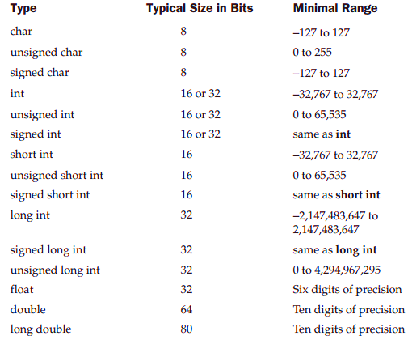

Slide 7
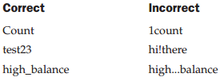
Identifier Names
In C/C++, the names of variables, functions, labels, and various other user-defined objects are called identifiers.
The first character must be a letter or an underscore, and subsequent characters must be either letters, digits, or underscores.

Slide 8
Identifier Names
In an identifier, upper- and lowercase are treated as distinct. Hence, count, Count, and COUNT are three separate identifiers.
An identifier cannot be the same as a C or C++ keyword, and should not have the same name as functions that are in the C or C++ library.

Slide 9
Variables
variable is a named location in memory that is used to hold a value that may be modified by the program.
All variables must be declared before they can be used.
The general form of a declaration is:
type variable_list;
Here are some declarations:
int i,j,l; short int si; unsigned int ui;

Slide 10
Const variables
Variables of type const may not be changed by your program. (A const variable can be given an initial value, however.)
const int a=10;

Slide 11
Variable Initializations
You can give variables a value as you declare them by placing an equal sign and a value after the variable name.
The general form of initialization is: type variable_name = value;
Examples
char ch = 'a'; int first = 0; float balance = 123.23;

Slide 12
cin
cin is defined in <iostream> header file.
cin is used to accept the input from the user
Genral form to accept single input :
Genral form to accept smultiple inputs:
cin >> varName;
cin >> var1 >> var2 >> … >> varN;

Slide 13
cout
cout is defined in <iostream> header file.
cout is used to output something to the user.
Genral form:
or
Genral form to display multiple outputs :
cout << varName;
cout << "Some String";
cout << var1 << "Some String" << var2 << endl;

Slide 14
Read two integer numbers from the user then print their sum and average.
#include<iostream> using namespace std; void main() { int num1, num2; cout << "Enter two numbers: "; cin >> num1 >> num2; cout << "sum of 2 numbers = " << num1 + num2<<endl; cout << "average of 2 numbers = " << (num1 + num2)/2 << endl; system("Pause"); }

Slide 15
Backslash codes
Code | Meaning
\b | Backspace
\n | New line
\t | Horizontal tab
\" | Double quote
\' | Single quote
\\ | Backslash

Slide 16
Read a positive integer from the user and print its square
#include<iostream> #include<math.h> using namespace std; void main() { int num; cout << "Enter number : "; cin >> num; cout << "Power = " << num *num <<endl; cout << "Power using Pow function " << pow(num, 2)<<endl; system("Pause"); }

Slide 17
END

